Slide 1

PornHub Analysis & Recommendation Engine
RMT DATA Part-Time Jan 2021
Final Project
LUCA CICEU
“All in the name of Science!”

Slide 2

WHAT’S ON THE MENU?
Problem & Data Source
A bit of insights
EDA
Can we really do it…
.. Did we do it?
Q & A

Slide 3

PROBLEM DEFINITION
Analyze the PornHub Dataset from Kaggle and try to:
Predict performer popularity (the number of video views)
Predict listing position (the PornHub performer ranking)
Recommend similar performers
Dataset source (Kaggle) : https://www.kaggle.com/data/206700

Slide 4
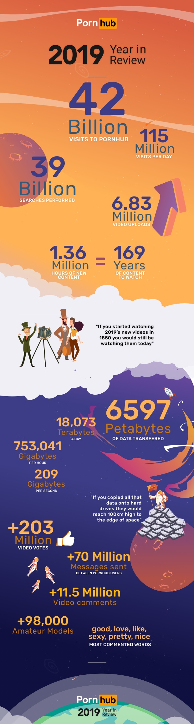
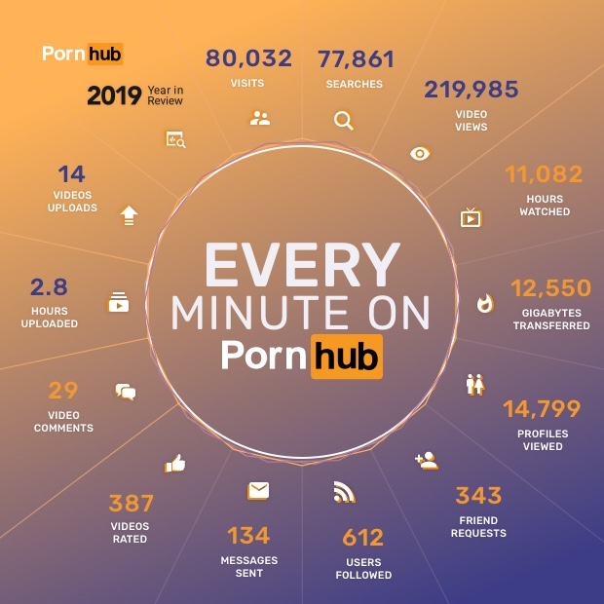

According to data from the SEMrush Traffic Analytics tool, porn sites received more website traffic in 2020 than Twitter, Instagram, Netflix, Zoom, Pinterest, and LinkedIn combined. (SEMrush)
Valuable links (for Data Science purposes..):
https://2date4love.com/pornhub-statistics/
https://www.pornhub.com/insights
https://www.ibisworld.com/industry-statistics/market-size/adult-pornographic-websites-united-states/
https://www.semrush.com/blog/most-visited-websites/

Slide 5

Top Ten Stats and Facts About Pornhub
The total number of Pornhub visits in 2018 was 33.5 billion.
In 2019, the number of visits jumped up to 42 billion.
For 2021, the number of daily visits sits around 130 billion (up from 115 in 2019)
Lana Rhoades is the highest ranked female pornstar , with a total of over 345 million views in 2015 and over 900 million in total
Mini Diva is the highest ranked model (amateur contributor), sitting in the 11th place with 364 million views
Leolulu is the highest ranked couple (18th place) with close to 669 million views
Jordi El Nino Polla is the highest ranked male performer (12th place) with close to 453 million views
Female Pornhub users are 186% more likely to check out lesbian porn compared to male users.
Globally, the most popular day to visit Pornhub is Sunday
There was a 24.4% peak increase in traffic on March 25th, 2020, after Pornhub offered a Free Premium to encourage visitors to stay indoors due to the coronavirus.

Slide 6
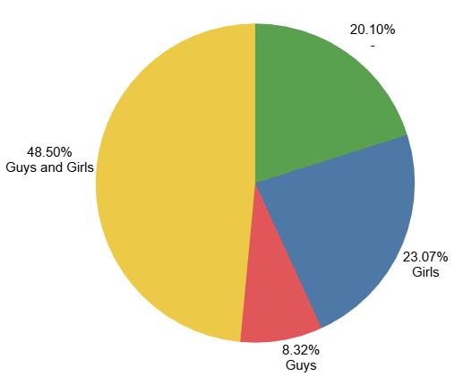
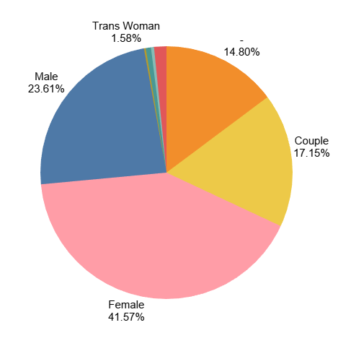
There were two files in the dataset, each with its own ranking (Models have Model Ranking, Pornstars have Pornstar Ranking). Both have Pornhub ranking, which is what I merged on (and one of the things we predict)
I merged the files in one dataset and did basic EDA on it; after clean-up some of the interesting things came up: - there are 17311 Pornstars (17.5%) in total and 81610 Models (82.5%)
the split between sexual orientation and identity suggest that “girls” top the preferences of the performers
You can also see that some people have undeclared preferences – 99% of the time that is also towards “girls”
Sexual orientation
Sexual identitiy

Slide 7


Predicting Performer Video Views
2. Predicting Performer PornHub Ranking (aka “List position”)
So, what are we looking for?
3. Suggesting alternative performers
“.. is a magic number”

Slide 8
Software :
Jupyter Notebook, Tableau, Excel, Flask, PyCharm, HTML, CSS
Libraries:
pandas, numpy, IPython, sklearn, xgboost, seaborn, mathplotlib, warnings, pickle
Modules/models/methods:
train_test_split, LinearRegression(), KNeighborsRegressor(n_neighbors=3, n_jobs=10), KNeighborsRegressor(n_neighbors=5, n_jobs=10), KNeighborsRegressor(n_neighbors=7, n_jobs=10), MLPRegressor(hidden_layer_sizes=(100,), alpha=0.0001, learning_rate_init=0.001, random_state=42), RandomForestRegressor(), RandomForestRegressor(bootstrap= True, max_depth= 10, max_features= 'auto', max_samples= 0.5, min_samples_leaf= 2, min_samples_split= 2, n_estimators= 100), GradientBoostingRegressor(random_state=0), XGBRegressor(n_estimators = 1000), XGBRegressor(), XGBRegressor(n_estimators=1000, learning_rate=0.05), XGBRegressor(bootstrap = True, max_depth= 5, max_features = 'sqrt', max_samples= None, min_samples_leaf=1, min_samples_split= 2, n_estimators= 50), StandardScaler, MinMaxScaler, RobustScaler, OneHotEncoder, mean_squared_error, mean_absolute_error, RFE, GridSearchCV, PCA, Kmeans, pairwise_distances, silhouette_score
Tech used

Slide 9
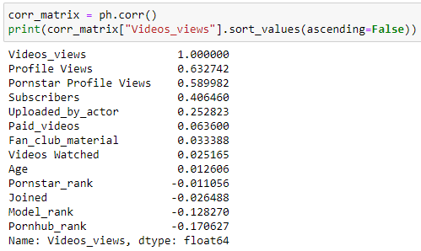

Predicting Performer Video Views
R2 Score (GradientBoostingRegressor(random_state=0):

Slide 10

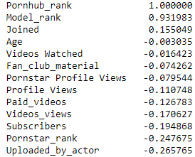
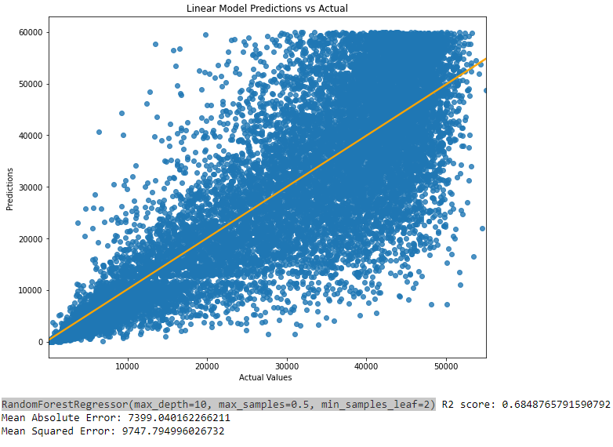
Step 1:
Predicting with the help of the Model / Pornstar rank
R2 Score (GradientBoostingRegressor(random_state=0):
0.9767552109324232
Step 2:
Predicting without the help of the Model / Pornstar rank (Benchmark)
R2 Score (GradientBoostingRegressor(random_state=0):
0.6366049990002114
R2 Score LinearRegression():
0.36963285119706524
Predicting PornHub Rank
Step 3:
Building a more reliable / truthful model:
No model/pornstar rank
Feature engineering + hyperparameter tunning
Standard Scaller
Applying all that to a function that loops trough 12 models
R2 Score RandomForestRegressor(max_depth=10, max_samples=0.5, min_samples_leaf=2)
0.6848765791590792

Slide 11


Suggesting alternative performers
Methods:
PCA,
Kmeans (+ elbow method & silhouette score),
pairwise_distances_argmin_min (both metric='euclidean’ & metric = 'cosine’),
pickle,
flask,
a bit of html tinkering
http://127.0.0.1:5000/rec
https://lucaciceu.pythonanywhere.com/rec

Slide 12

What could have been done more?
Use Natural Language Processing (NLP) on the text-heavy columns (Bio, Interests and hobbies, Turn Off, Turn On, etc.)
Test other Learning to rank (LTR) algorithmic techniques (maybe in conjunction with search keyword volumes)
What would have helped?
Less data imbalance in some columns (gender, age, interests, measurements, endowment, etc.)

Slide 13



